Slide 1
User Experience
PerlSquad

Slide 2
Experimental Conditions
Five different biomes (Deciduous forest, Desert, Tundra, Rainforest, Grassland)
Users are graduate students in Dr. Dani’s program
Users are interacting with the game from http://biomegame.online

Slide 3
Tasks
Users will do the following:
Choose a biome
Press “OK” and continue to the “Info Screen”
They have unlimited time to browse around the info screen and learn about the animals, precipitation, etc, in the biome
They will continue to the “Scroll Game”
Here they must play the game by clicking “correct” animals until it ends because they let one such animal go across the screen without clicking it. (The user is expected to know which animals are correct from the information learned on the previous screen)

Slide 4
Logged Data Types
What biome the user is in
The number of “correct” animals clicked
The number of “incorrect” animals clicked
How long the user spent on the “info screen”
How long the user spent playing the “scroll game”

Slide 5
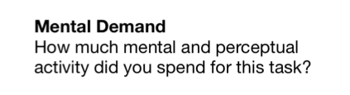
Questionnaire
We will use NASA TLX questionnaire
Why?
Questions such as the one below capture how the user felt during this learning process and we can see if the game is an effective educational tool.

Slide 6
Experimental Procedure
There are not many constraints
Users may be wherever they feel most comfortable to learn
They have unlimited time to complete the tasks
Data is logged on a rolling basis after each user finishes playing the “scrolling game” so we may evaluate the results.
Users then take the survey

Slide 7
Subject Description
Dr. Dani’s (client) graduate students.
At a later point, it would be nice to test it with the other audience. (K-3rd graders)

Slide 8
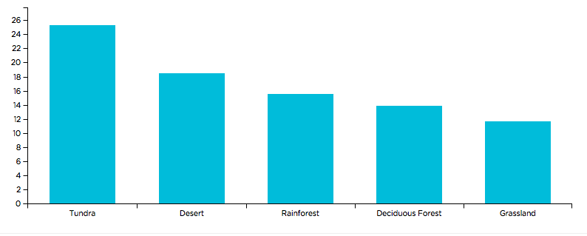
Results
The image below depicts the number of “correct” animals clicked in each biome
We can see that the biome with the least “correct” clicks is the Grassland
Why?
Perhaps the animals are harder to click due to orientation or size
Perhaps it’s the order of the biomes and testers are just “tired” when they get to it

Slide 9
Reflection
This was a worthwhile and informative experience. We gained some insight into what our users are thinking as they progress through the game. We can now make appropriate changes to the different biomes so they are of equal difficulty to the users.

